Slide 1
DATA SCIENCE Instructor: Prof. Shuen Lin Jeng Team member: 徐仁瓏 RE6121011 Jen-Lung Hsu 吳明軒 RE6124019 Ming-Hsuan Wu 曾文海 RE6124027 Wen-Hai Tseng 李家銘 RE6124043 Chia-Ming Lee

Slide 2


Project title & Target problems
Project Title:
Predicting Stock Prices of Real Estate Investment Trusts Using Real Estate Information
Target Problems:
Our goal is to use real estate transaction data to predict the stock prices of Real Estate Investment Trusts (REITs). We plan to forecast signals related to stock price fluctuations using data science techniques.

Slide 3
Importance & Novelty
Importance:
Comprehensive Market Understanding:
Know real estate transaction data
Know real estate investment trust (REIT) information
Find relationships between both market
Multidimensional Analysis
Machine learning can be employed to analyze this data
Evaluate market conditions from multiple dimensions
Provide investment indicators
Novelty:
Real-Time Monitoring and Decision Support:
Using machine learning technology, you can achieve real-time monitoring
Helping investors adjust their investment strategies more quickly.
Risk Management and Opportunity Identification:
Machine learning can assist in identifying potential risks
This contributes to the development of more effective for portfolio optimization.

Slide 4
Data description
Real Estate Investment Trusts (REITs) Data:
https://api.tej.com.tw/columns.html?idCode=TWN/AAPRRENT
https://api.tej.com.tw/columns.html?idCode=TWN/AAPRTRAN
https://api.tej.com.tw/columns.html?idCode=TWN/ALANDTR
Real Transaction Data (Real Price Registration Information):
https://goodinfo.tw/tw/StockList.asp?MARKET_CAT=%E5%85%A8%E9%83%A8&INDUSTRY_CAT=%E4%B8%8D%E5%8B%95%E7%94%A2%E6%8A%95%E8%B3%87%E4%BF%A1%E8%A8%97%E8%AD%89%E5%88%B8

Slide 5

Paper Report
政府打炒房的租稅與行政措施對於臺灣營建類股股價的影響-以事件研究法分析
Nonlinear Short-Run Adjustments between House and Stock Prices in Emerging Asian Regions
The dynamics of the relationship between real estate and stock markets in an energy-based economy: The case of Qatar
Research and Analysis of the House Price Prediction using Artificial Intelligence Models

Slide 6
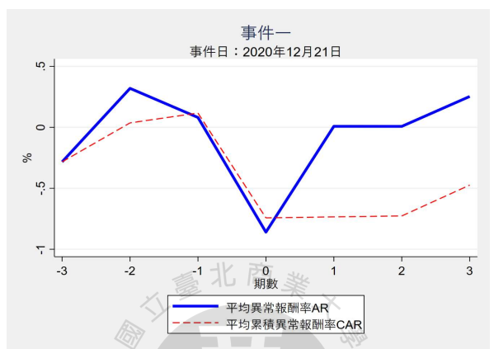
1 政府打炒房的租稅與行政措施對於臺灣營建類股股價的影響-以事件研究法分析
A. The purpose of the research
This research aims to investigate the effects of Taiwan's late 2020 anti-speculation housing policies on the stock prices of Taiwanese construction companies. The three key policies under examination include the Ministry of Finance's House and Land Tax 2.0, the Ministry of Interior's Real Estate Actual Price Registration 2.0, and the Central Bank's Selective Credit Control.
B. The main methods and approaches
The main method used is event study methodology. Specifically, the market adjusted returns model is used to estimate expected returns, and the sign test is used to examine abnormal returns around policy announcement dates.
AR:-0.8597
P-Value=0.00
Research sample collection period:2020/12/21~2021/12/19
Number of stocks: 79
Number of events: 9
Notes:
本研究旨在調查台灣2020年底的反投機房屋政策對台灣建築公司股價的影響。三個正在審查的重點政策包括財政部的房屋土地稅2.0、內政部的房地產實際價格登記2.0以及央行的選擇性信貸控制。
主要使用的方法是事件研究法。具體來說，採用市場調整收益模型來估計預期收益，並採用符號檢定來檢驗政策公佈日前後的異常收益。

Slide 7
1 政府打炒房的租稅與行政措施對於臺灣營建類股股價的影響-以事件研究法分析
C. The relation to your project
In a research paper, selecting publicly traded companies related to the research topic as the sample, you can similarly choose variables related to real estate investment trust securities for analysis. The paper utilizes stock price returns as the dependent variable, and you can consider selecting variables such as net asset value and yield for real estate investment trust securities as the dependent variables.
D. The key accomplishment of the paper
The anti-speculation housing policies generally had a significant negative impact on construction company stock prices around announcement dates.
The tax policy (House and Land Tax 2.0) had the most significant negative impact.
There was some evidence of anticipatory effects, with negative abnormal returns occurring before later policy announcements, indicating some forward-looking behavior by investors.
Notes:
論文中選取與研究議題相關的上市公司作為樣本,類似的您也可以選取與不動產投資信託證券相關的變數作為分析資料。 論文以股價報酬率作為被解釋變數,您可以考慮選取不動產投資信託證券的淨值、收益率等作為被解釋變數。
反投機住房政策總體上對公告日期前後建築公司的股價產生了顯著的負面影響。
稅收政策（房屋和土地稅2.0）的負面影響最為顯著。
有一些預期效應的證據，在後來的政策宣布之前就出現了負的異常回報，這表明投資者存在一些前瞻性行為。

Slide 8
2 Nonlinear Short-Run Adjustments between House and Stock Prices in Emerging Asian Regions
A. The purpose of the research
The purpose of the research is to examine whether there is a nonlinear cointegration relationship between house prices and stock prices in China and the four Asian Tigers (Taiwan, Hong Kong, South Korea, Singapore). The authors also want to analyze the short-run adjustment dynamics when deviations from the long-run equilibrium occur between house and stock prices.
B. The main methods and approaches
nonparametric cointegration test
smooth transition vector error-correction model (STVECM)
Granger causality test
Taiwan (1998 Q1 ~2010 Q2)
This paper does not involve the prediction of stock prices.
Notes:
這項研究的目的是檢驗在中國和亞洲四小虎國（台灣、香港、南韓、新加坡）之間，房價和股價是否存在非線性的協整關係。 作者們還希望分析當房價和股價之間發生長期均衡的偏差時，短期調整動態的情況。
B
nonparametric cointegration test 房價格指數和相對應的股票價格指數之間存在非線性的長期共整關係(長期兩者價格應差不多)
STVECM 房價和股價存在較大偏離時,它們短期動態(每月或每季)回歸平衡的調整效率。
Granger causality test 檢驗不同經濟和金融變量(如:房價、股價)之間的因果關係

Slide 9
2 Nonlinear Short-Run Adjustments between House and Stock Prices in Emerging Asian Regions
C. The relation to your project
The paper employs a nonparametric cointegration test to capture the nonlinear short-term adjustment relationships between house and stock prices, which can serve as foundational knowledge for analysis.
The analysis of the price discovery process and short-term adjustment speeds (STVECM) in the paper provides recommendations for modeling work.
The methods we have learned from the paper, such as cointegration tests, smooth transition models, Granger causality tests, etc., are all relevant to exploring the relationship between house and stock prices, and they encompass information pertaining to Taiwan.
D. The key accomplishment of the paper
Finding evidence of nonlinear cointegration between house and stock prices in China, South Korea, Singapore and Taiwan using nonparametric tests.
Demonstrating STVECM can appropriately model the nonlinear error correction dynamics with smooth transition between regimes.
Showing adjustment speeds are asymmetric, with house prices adjusting faster than stocks to deviations from equilibrium.
Notes:
該論文採用nonparametric cointegration test捕捉房價和股價之間的非線性短期調整關係，這可以為分析做為基礎知識
論文中對價格發現過程和短期調整速度(多長時間)的分析也可以為建模工作提供深刻見解。
我們從論文中學到的方法，如協整檢驗、平滑過渡模型、格蘭杰因果關係檢驗等，都符合探討房價與股價的關係，且包含台灣的資訊。
利用非參數測試發現在台灣的房價和股價之間存在非線性協整的證據。 (Taiwan r=0(房價股價不存在關係) 0.008 拒絕，所以台灣兩價間具有長期協整關係)
展示STVECM能夠適當地建模非線性的誤差修正動態，實現在不同階段之間的平滑過渡。(房價格的回歸速度大於股票價格)
顯示調整速度是非對稱的，即房價對於偏離均衡的調整比股票更快。 (台灣地區存在財富效應，對我們而言就說明股價是有可預測性的。)

Slide 10
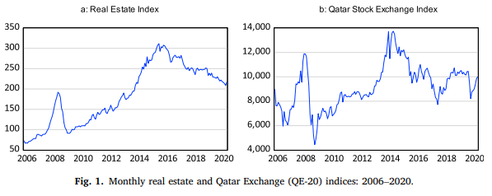
3 The dynamics of the relationship between real estate and stock markets in an energy-based economy: The case of Qatar
A. The purpose of the research
Provide valuable insights into the short and long-term dynamics of these markets, which can help investors improve their strategies in both markets and guide policymakers to initiate effective policies on the financial economics of real estate development and investment in Qatar.
B. The main methods and approaches
The proposed method includes ADRL model, Granger causality test, Switching regression model. Overall, these methods and approaches provide a comprehensive analysis of the dynamic linkages between real estate and stock markets in Qatar, and help to uncover the short and long-term dynamics of these markets.
Notes:
The purpose of the research
提供有關這些市場的短期和長期動態的見解，這可以幫助投資者改進在兩個市場的策略，並指導政策制定者針對卡達房地產開發和投資的金融經濟制定有效的政策。
The main methods and approaches
總體而言，這些方法和途徑對卡達房地產和股票市場之間的動態聯繫進行了全面分析，並有助於揭示這些市場的短期和長期動態。
The real estate index (REI) dataset used in this study covers the period from April 2006 to September 2020 and was sourced from QCB. The QE-20 index and macroeconomic factors were collected from DataStream, with a total number of 174 observations.
資料是從卡達的某個官網(QCB卡達專門蒐集資料的公司)獲取的
實價登陸資料從2006到2020 (單位應該從日到年都有)
巨觀經濟(股市/房市)是從他們經濟部門蒐集的(總共174筆data)
具體來說 實價登陸與股票市場的行情是有一定正相關的(一個好另外一個也會好)，本研究主要囊括兩個方向(1)找出顯著影響市場行情的關鍵事件或時間節點(2)找出這關鍵事件後，再找出從資料分析關鍵的影響因子

Slide 11
3 The dynamics of the relationship between real estate and stock markets in an energy-based economy: The case of Qatar
C. The relation to your project
The article offers valuable insights into Qatar‘s real estate sector, its connection with the stock market, and underscores the importance of reliable real estate information in decision-making processes. We can learn some valuable insights from this paper, despite there are some different development between the history of these country (Qatar and Taiwan)
D. The key accomplishment of the paper
Providing valuable insights into the short and long-term dynamics of these markets, which can help investors improve their strategies in both markets and guide policymakers to initiate effective policies on the financial economics of real estate development and investment in Qatar.
Notes:
The relation to your project
文章也強調了卡達作為唯一建立每月全國房地產價格指數的海灣國家的獨特性。 這些數據在指導卡達房地產開發和投資的明智決策方面發揮關鍵作用。
The key accomplishment of the paper
總而言之，本文提供了有關卡達房地產行業及其與股票市場的聯繫的寶貴見解，並強調了可靠的房地產資訊在決策過程中的重要性。我們可以從此論文中得到一些有用的洞見，儘管兩個國家歷史發展有所不同
我覺得的話 這篇文章給我的收穫是
1. 我透過這篇文章了解哪些tool可以用於這種資料 or 房價/股價之間的比較
2. 這篇文章介紹卡達的房價崛起背景不少，例如他是能源起家的，以及它是海灣國家...etc
3. 此外就是比較重要的一點是 和2掛勾 能源因素(可能受其他國家影響) 對房價股價很敏感 (能源供給與通膨率/房地產價格存在長期的交互關係)
4. 調查期間大概在2006~2020之間，而中東一直不太安定，所以這種分析/做任何檢定很容易做，我覺得借鑒台灣的話就是台海安定與否

Slide 12
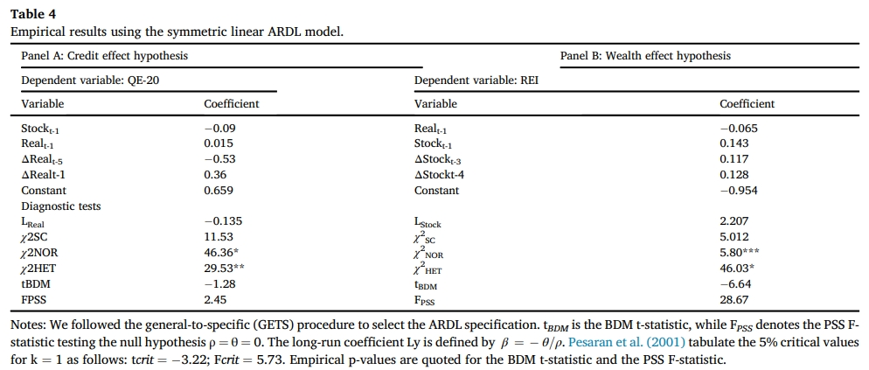
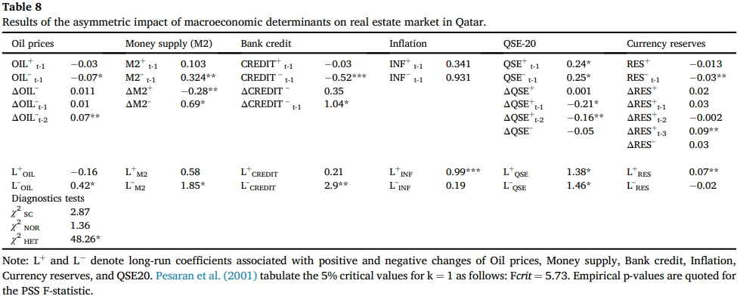
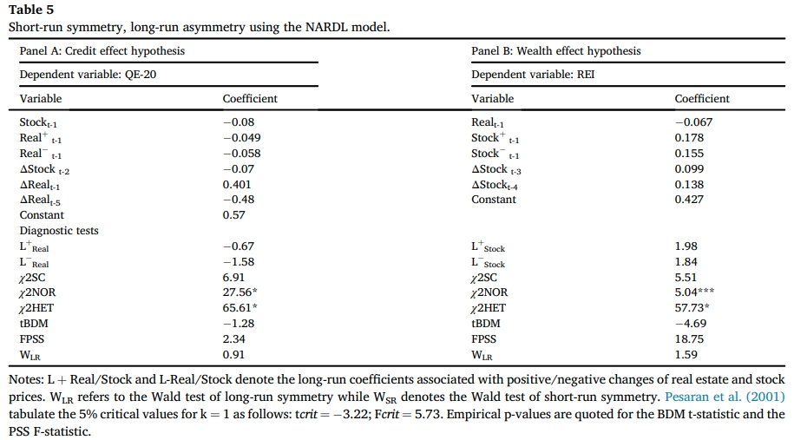
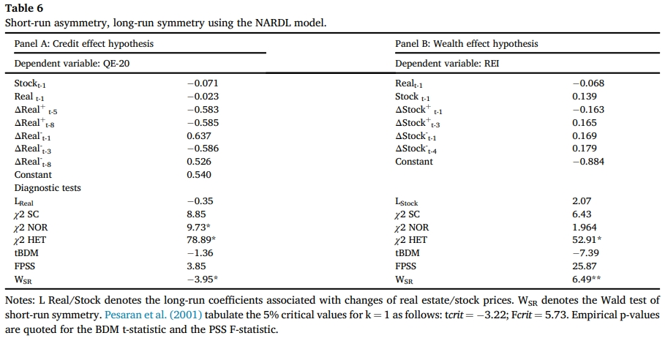
E. The experiment results (*:0.01,**:0.05,***:0.1)

Slide 13
4 Research and Analysis of the House Price Prediction using Artificial Intelligence Models
A. The purpose of the research
The research aims to harness the power of deep learning techniques to accurately forecast housing prices across various neighborhoods within Taipei City.
B. The main methods and approaches
The primary methods and approaches encompass a diverse range of models, including linear regression, multilayer perceptron, and the sophisticated LSTM (Long Short-Term Memory) model, in conjunction with well-known optimization algorithms such as Adam, SGD (Stochastic Gradient Descent), and RMSProp.
Notes:
應用深度學習方法預測台北市區域房價
資料時間: 2017~2019第一季的實價登陸資料
資料來源: 政府資料開放平台的不動產買賣時價登錄批次資料
模型: 線性迴歸, 多層感知器, LSTM長短期記憶模型 優化器: Adam, SGD, RMSProp

Slide 14
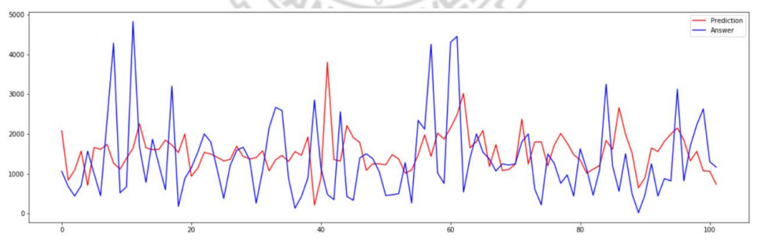
4 Research and Analysis of the House Price Prediction using Artificial Intelligence Models
C. The relation to your project
In the context of your project, both initiatives share a common thread in their use of machine learning and deep learning models to analyze and make predictions based on intricate time series data.
D. The key accomplishment of the paper
The crowning achievement of the paper lies in its compelling evidence that the LSTM model consistently delivers robust and highly accurate predictions, thereby enhancing our understanding of the dynamics of housing prices in Taipei City.
 | Loss(MSE) | Val_loss | FastDTW
LSTM | 0.0364 | 0.0477 | 3716845.21
房價單位：萬元
Notes:
同為透過機器學習或深度學習模型在時間序列資料中的應用 LSTM模型可達到良好的預測效果

Slide 15

Exploratory Data Analysis
Data summarization and visualization.

Slide 16
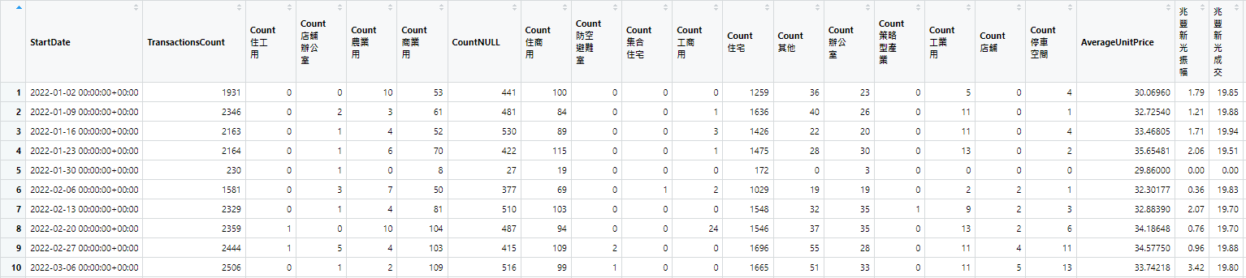
合併後資料
將台北、台中、台南的不動產實價登錄資料以週為單位合併
計算三都的每週的不動產交易量、不動產用途以及平均每坪價格
從不動產投資信託證券抓取每週的兆豐新光振幅和成交價

Slide 17
欄位介紹
欄位名稱 | 定義
StartDate | 2022年第1週到第52週 2022-01-02為第1週的開始日期 2022-12-25為第52週的開始日期
Transactions Count | 三都每週的不動產交易量
Count_ | 三都每週的不動產交易之主要用途
Average Unit Price | 三都每週的平均每坪房價
兆豐新光振幅 | 兆豐新光股票每週的振幅
兆豐新光成交 | 兆豐新光股票每週的平均成交價
資料筆數: 52 x 21

Slide 18
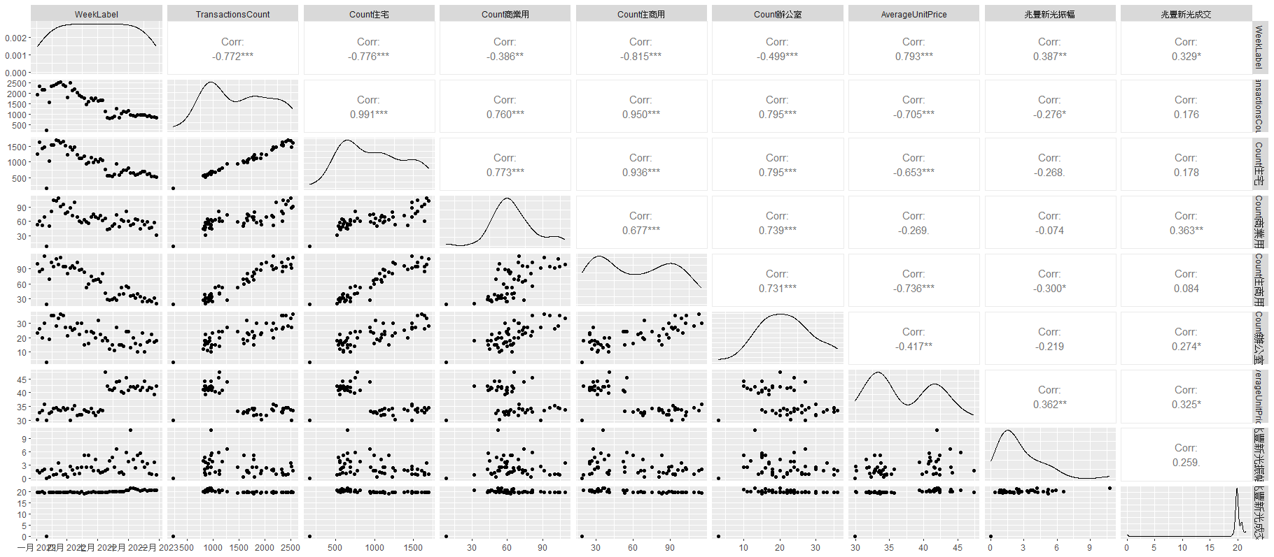
變數間的相關性

Slide 19
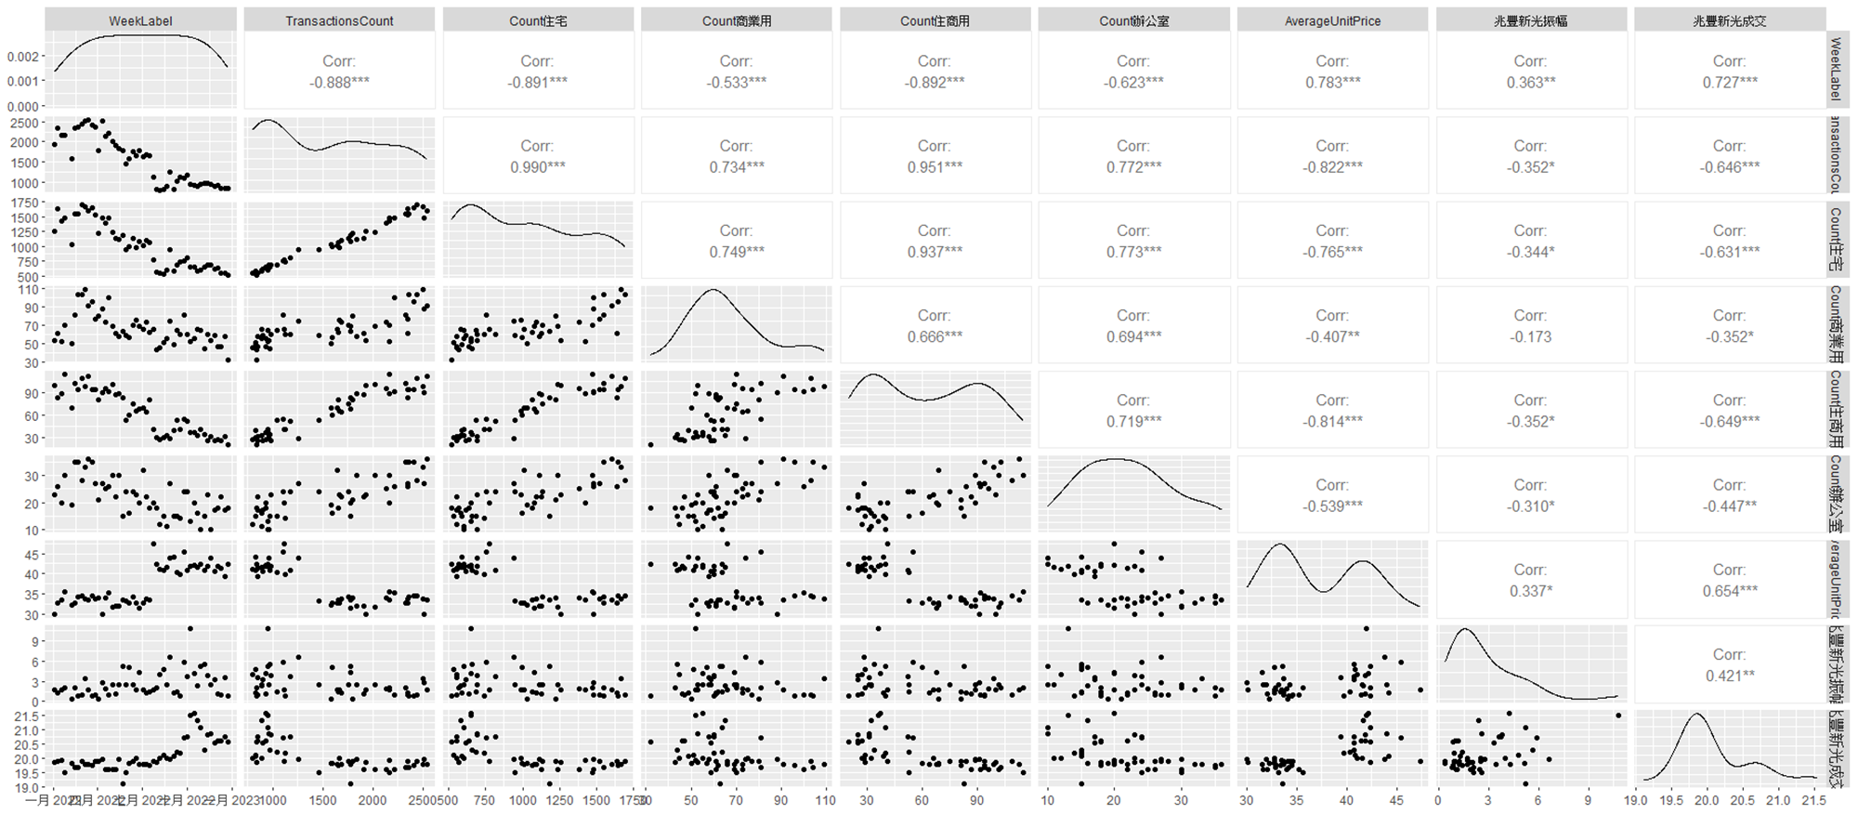
變數間的相關性(修正後)

Slide 20
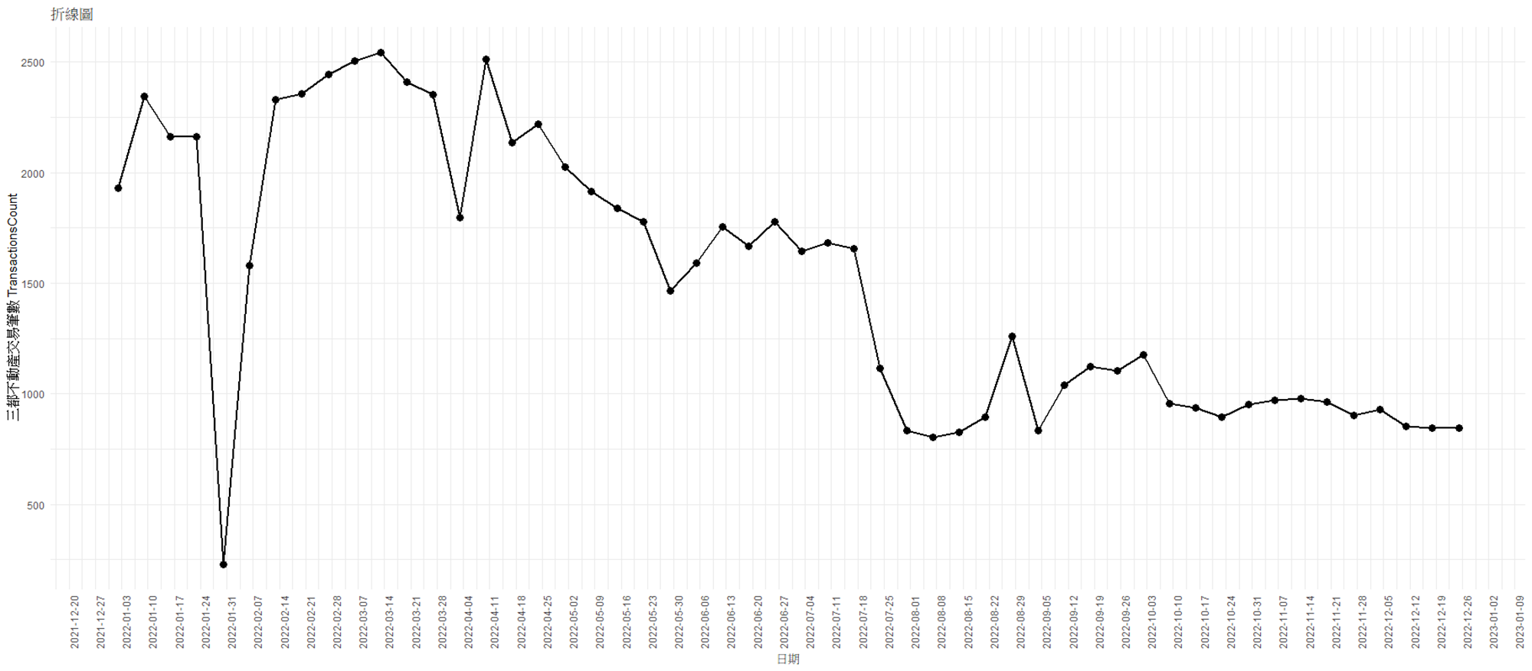
三都不動產交易筆數的趨勢

Slide 21
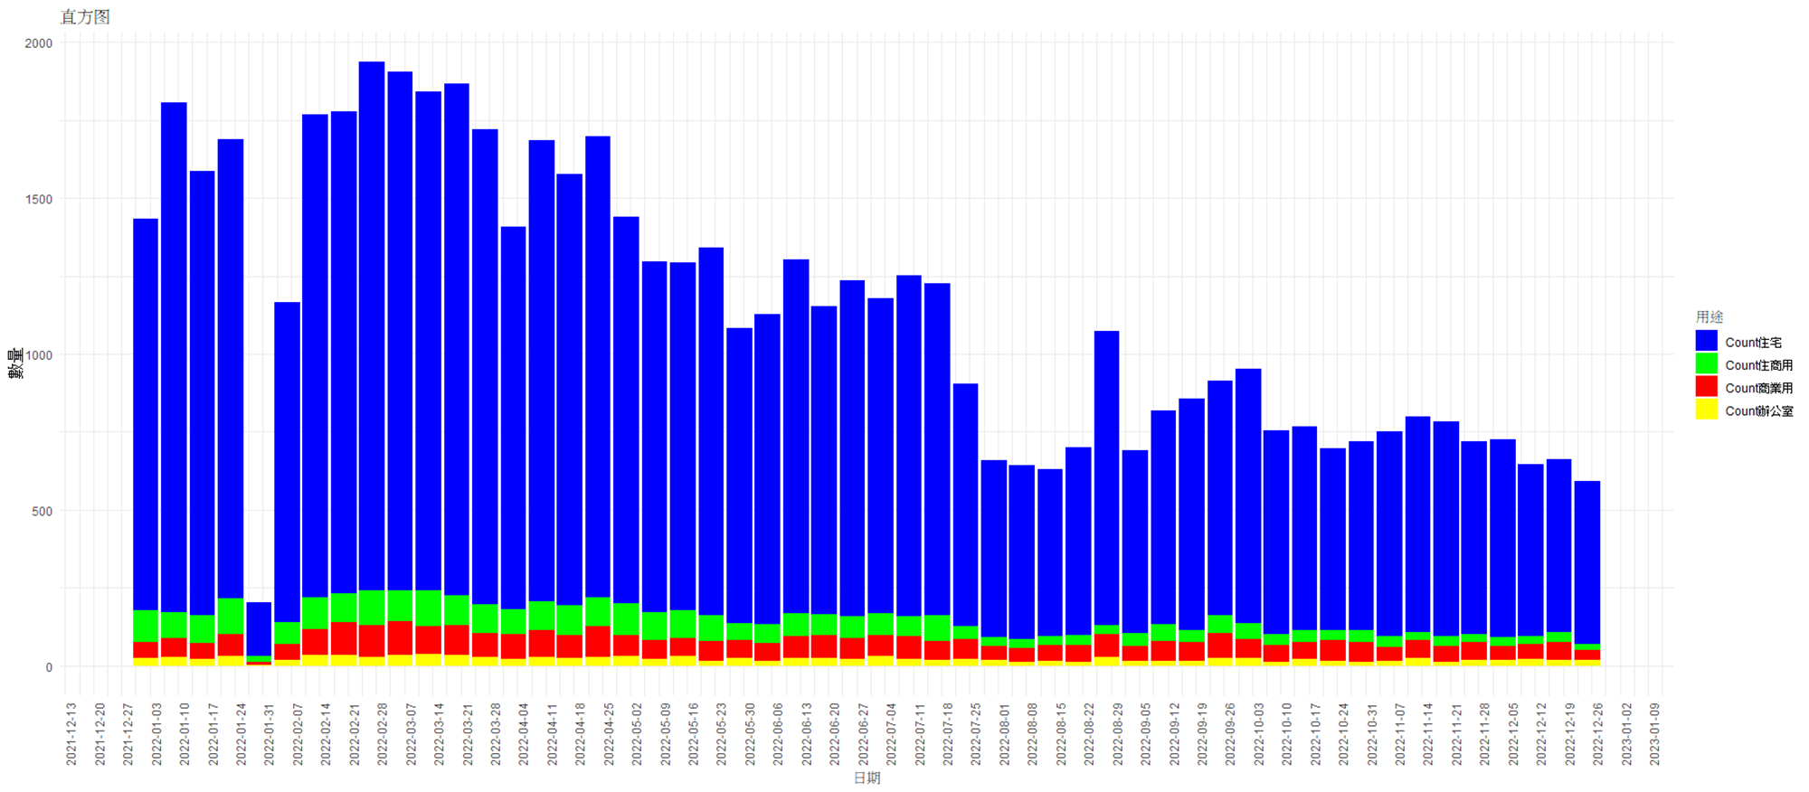
三都不動產交易主要用途的趨勢

Slide 22
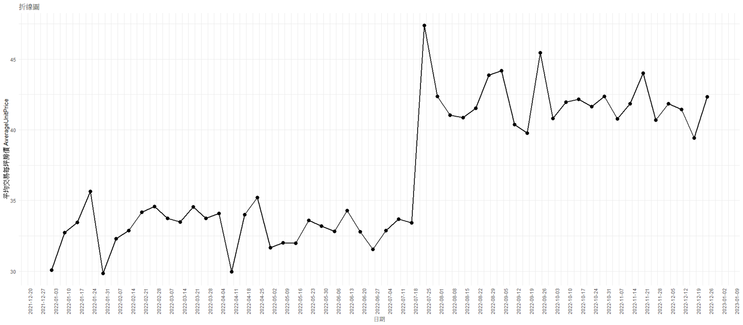
三都不動產平均每坪房價的趨勢

Slide 23
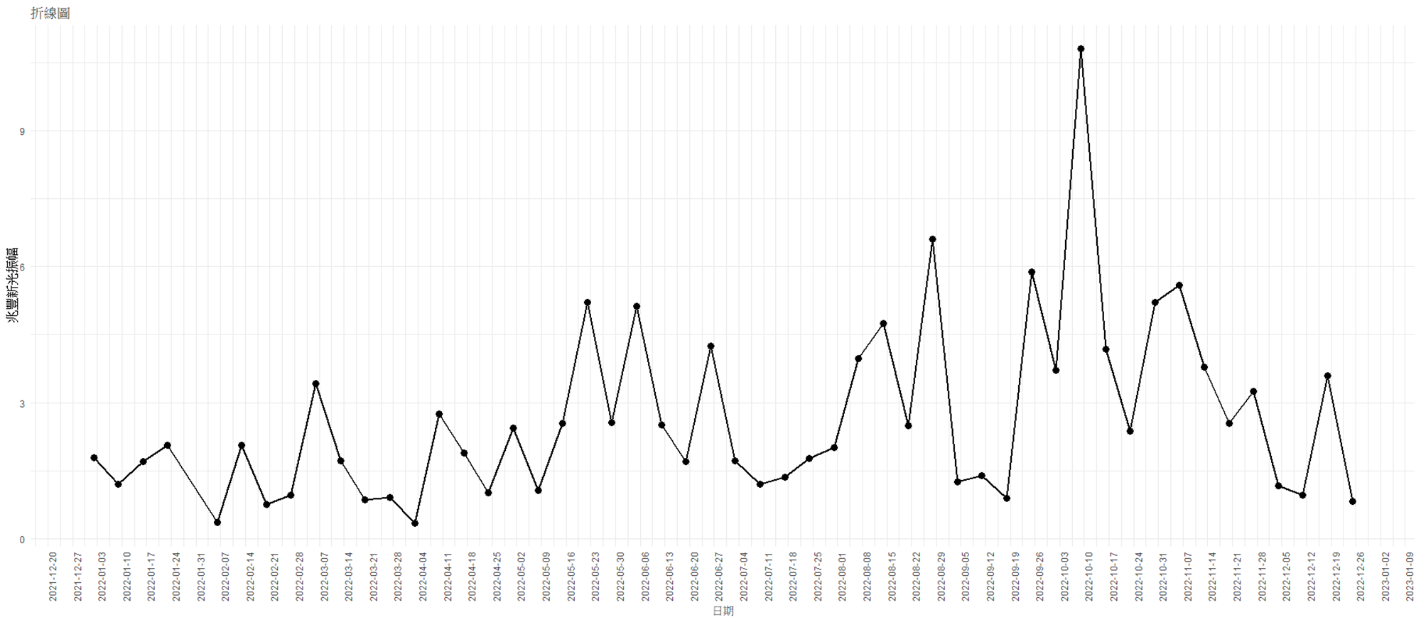
兆豐新光振幅的趨勢

Slide 24
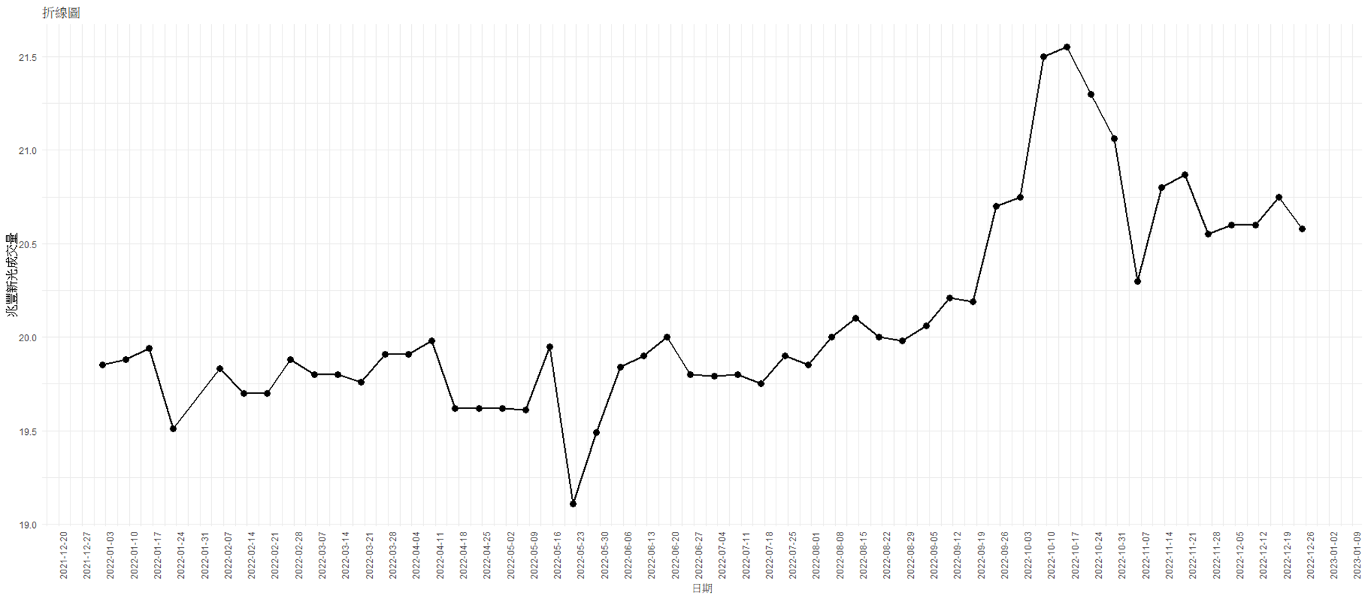
兆豐新光成交價的趨勢

Slide 25
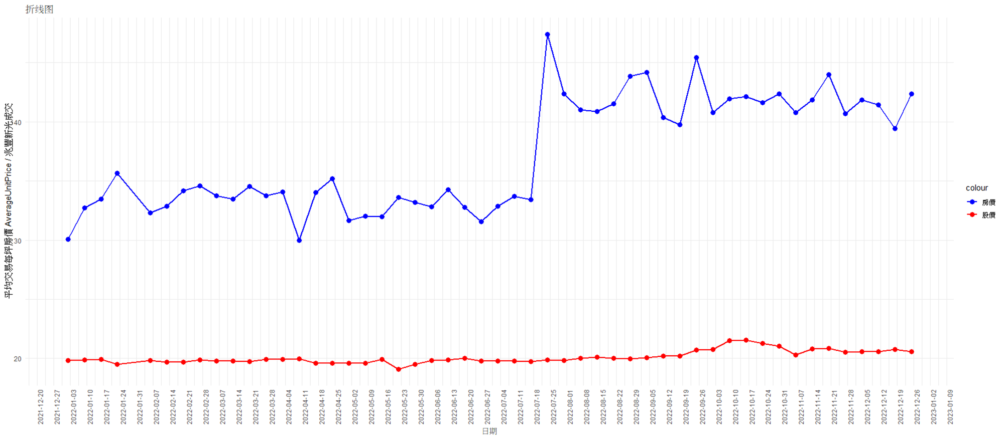
三都不動產房價&兆豐新光成交價的趨勢

Slide 26
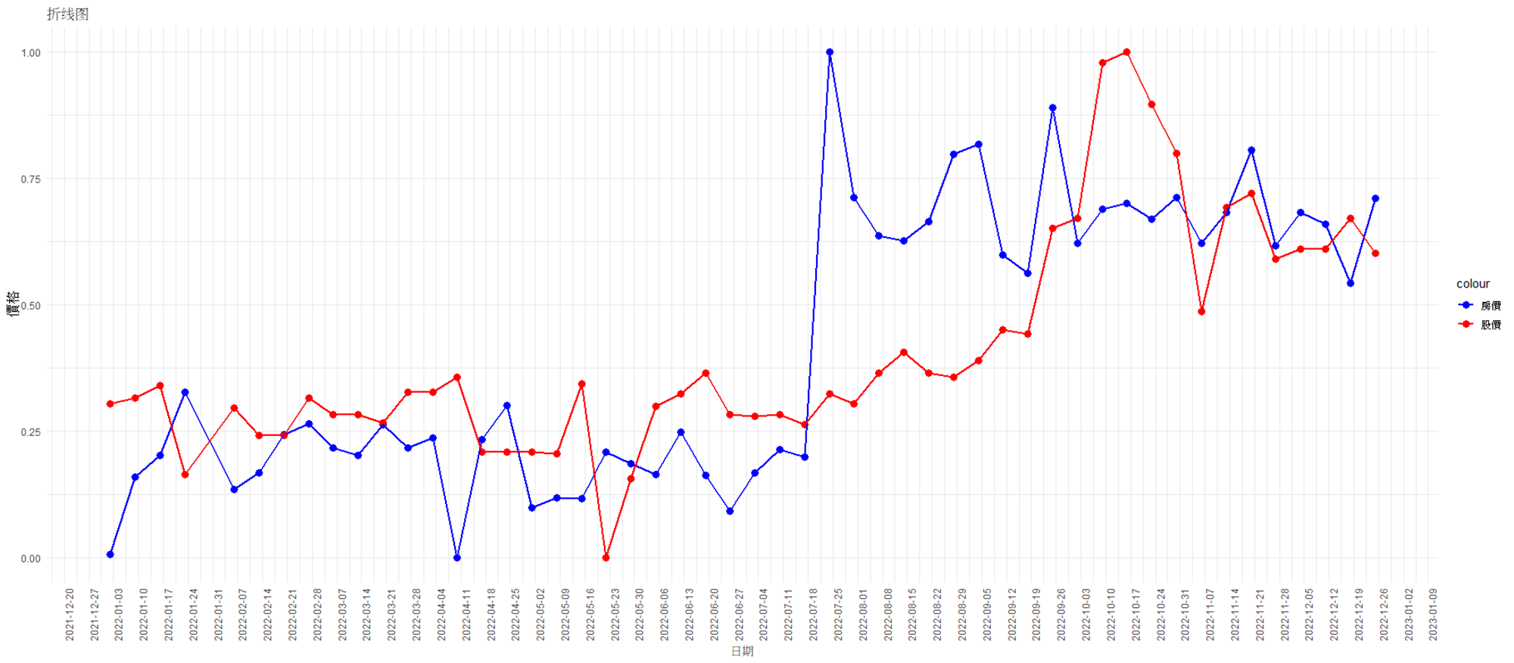
三都不動產房價&兆豐新光成交價的趨勢

Slide 27

Model Fitting and Prediction

Slide 28
Flowchart
資料處理
模型擬合與預測
實價登錄
Linear Regression
Decision Tree
Groupby Day
Tabel
Fine tune parameter
Random Forest
不動產投資信託證券
XGBoost
連結兩個資料
SVM

Slide 29
台北(A)、台中(B)、台南(D)、高雄(E)、新北(F)、桃園(H)
實價登錄欄位
欄位名稱 | 欄位解釋 | 欄位名稱 | 欄位解釋
coord_x | 緯度 | build_area | 該筆不動產的建物移轉面積
coord_y | 經度 | room | 該筆不動產房間數
land | 交易的土地筆數 | hall | 該筆不動產廳數，含客廳及餐廳
build | 交易的建物筆數 | health | 該筆不動產衛浴數
berth | 交易的車位元筆數 | berth_area | 該筆不動產車位移轉的總面積
land_area | 該筆不動產的土地移轉面積 | tot_prc | 該筆不動產成交總價
tran_up_ll | 該筆交易移轉地上樓層層數 | unit_prc | 該筆不動產成交的單價
tot_floor | 該筆不動產總樓層數 | berth_prc | 該筆不動產車位元的交易價格
room_age | 該筆不動產的屋齡 | coid | 縣市代碼及名稱

Slide 30
Data Preprocessing
移除問題很大的欄位
移除屋齡和建造日期為空的資料：移除 467,890 筆。
移除交易標的為車位資料的記錄：移除 6,049 筆。
移除交易標的為土地資料的記錄：移除 168 筆。
移除非都市土地使用分區為空的資料：移除 34,484 筆。
移除非都市土地使用分區相關的變數：由於4.已移除，所以剩下的全部都是遺失值。
移除備註資訊：移除備註資訊，因為原因太廣，不利於建模。
移除abnorm_prc欄位：移除 116 筆，因為不知道總價格的資料。
移除abnorm_td欄位：由於全部的交易日期都正常，移除abnorm_td欄位。
移除abnorm_loc欄位：移除 4,270 筆，因為不知道地址的資料。
移除tsign欄位：移除 2 筆，因為不知道交易標的的資料。

Slide 31
Data Preprocessing
缺值填補
將都市土地使用分區資訊中為空的資料設為其他或99：共有 5,982 筆。
將主要用途資訊中為空的資料設為其他或99：共有 18,830 筆。
將建材資訊中為空的資料設為其他或99：共有 109 筆。
將車位資訊中為空的資料設為Z：共有 301058 筆
處理日期
將mdate提取年、月、日、星期幾
將ann_date 提取年、月、日、星期幾

Slide 32
Data Preprocessing
其他處理
district_id or district 意思一樣，只是一個文字一個數字，則一保留
bstate (套房(1房1廳1衛)) or bstate_fg (4) 意思一樣，只是一個文字一個數字，則一保留
tran_tp (不動產/預售屋) or tran_tp_fg (A/B) 意思一樣，只是一個文字一個數字，則一保留
# 原520546 - 餘489812--->移除掉30734筆 類別變數中 極少數類別 的樣本
# 過濾掉類別出現次數低於1000的行
# 計算每個類別的出現次數
# 找出出現次數 >= 10 的類別
# 保留這些類別的行

Slide 33
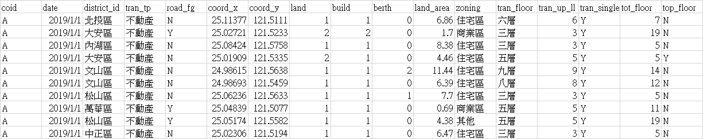
台北(A)、台中(B)、台南(D)、高雄(E)、新北(F)、桃園(H)
Feature Engineer
資料時長:2019~2021
Train時段:2019.1~2021.6
Test時段:2021.6~2021.12
將同天日期實價登錄資料平均並按照縣市做資料處理並且對應當日的股票價格。
17 * 6 = 102
將產生102個特徵
特徵欄位數量+ 縣市
最後將前三天的實價登錄資料與今日實價登錄資料連結，最終特徵411個特徵。
102 + 102 * 3 + 3 = 411
今天實價登錄資料 + 前三天實價登錄資料+ 前三天收盤價

Slide 34
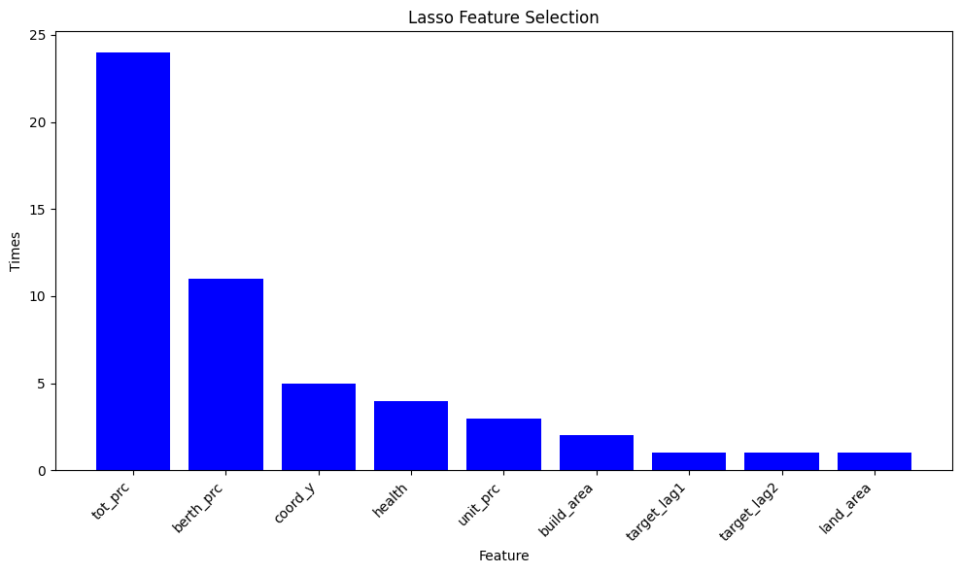
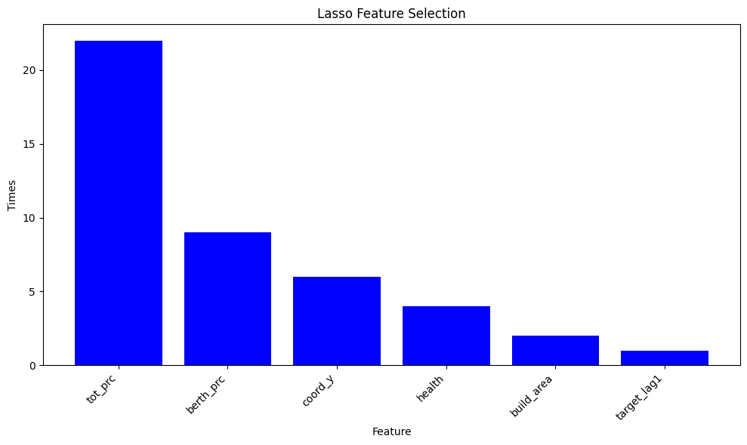
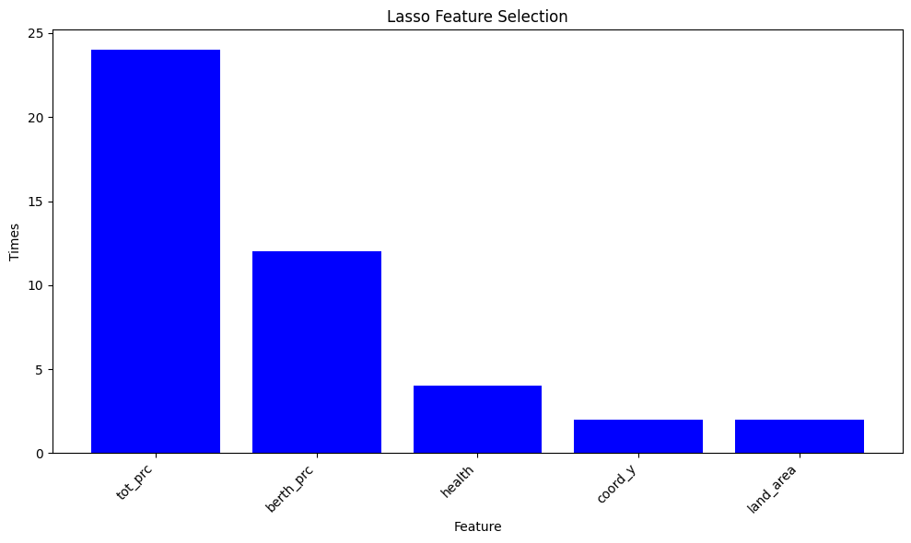
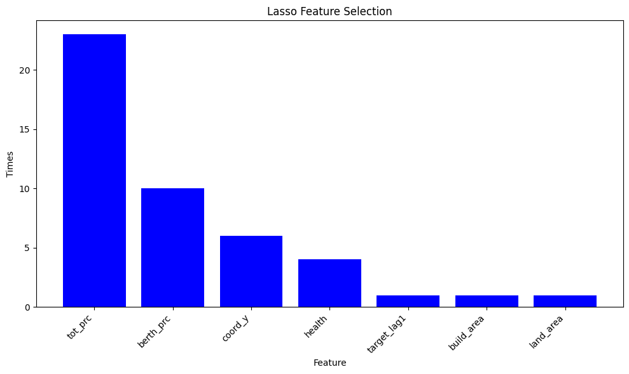
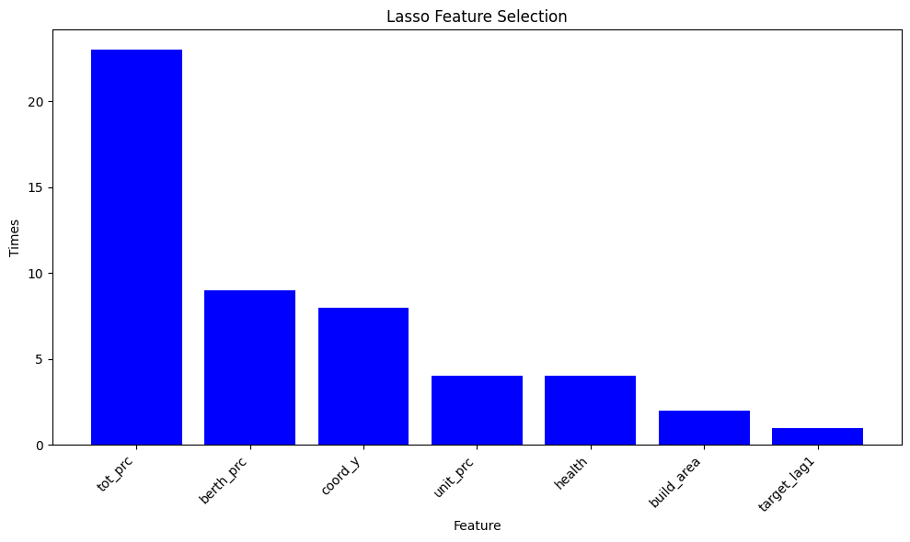
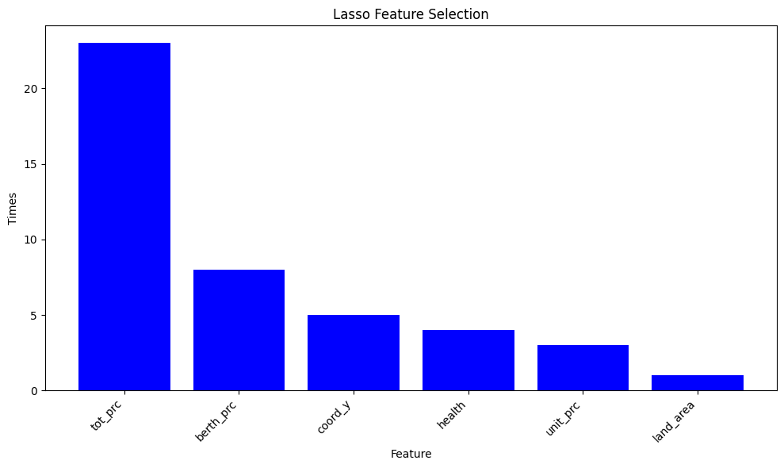
台北(A)、台中(B)、台南(D)、高雄(E)、新北(F)、桃園(H)
Feature Selection-Lasso
透過Lasso對不同股票挑選出特徵:
01001T: 52個
01002T: 46個
01004T: 44個
01007T: 51個
01009T: 44個
01010T: 44個

Slide 35
台北(A)、台中(B)、台南(D)、高雄(E)、新北(F)、桃園(H)
交叉驗證
各個模型的Hyperparameter交叉驗證最好參數紀錄
Model | Hyperparameter
 | 01001T | 01002T | 01004T | 01007T | 01009T | 01010T
DT | max_depth=5 min_samples_leaf=4 | max_depth=15 min_samples_leaf=2 min_samples_split=10 | max_depth=10 min_samples_split=5 | max_depth=15 min_samples_leaf=4 | min_samples_leaf=4 min_samples_split=5 | max_depth=5
RF | max_depth=5 min_samples_leaf=2 n_estimators=50 | min_samples_leaf=2 min_samples_split=5 n_estimators=50 | max_depth=5 min_samples_split=10 n_estimators=50 | max_depth=5 min_samples_leaf=2 min_samples_split=10 | max_depth=15 min_samples_leaf=4 n_estimators=50 | max_depth=10 n_estimators=50
XGBoost | learning_rate=0.1 max_depth=3 n_estimators=300 | learning_rate=0.1 max_depth=7 n_estimators=100 | learning_rate=0.1 max_depth=3 n_estimators=300 | learning_rate=0.1 max_depth=7 n_estimators=200 | learning_rate=0.1 max_depth=3 n_estimators=200 | learning_rate=0.1 max_depth=7 n_estimators=100
SVM | C = 10 | C = 10 | C = 10 | C = 10 | C = 10 | C = 10

Slide 36
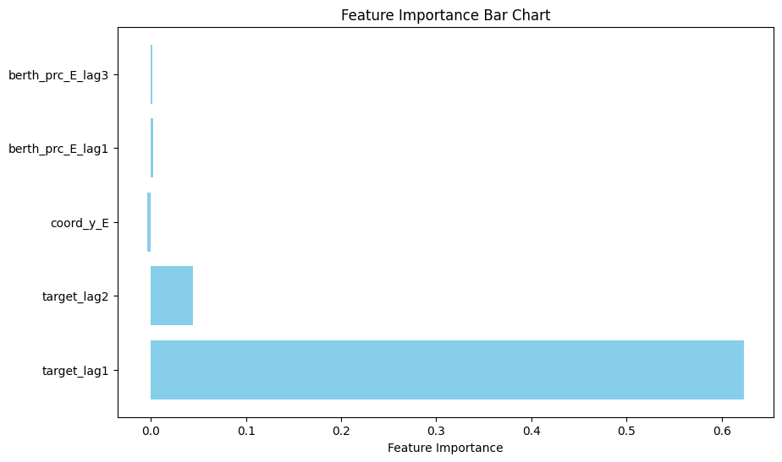
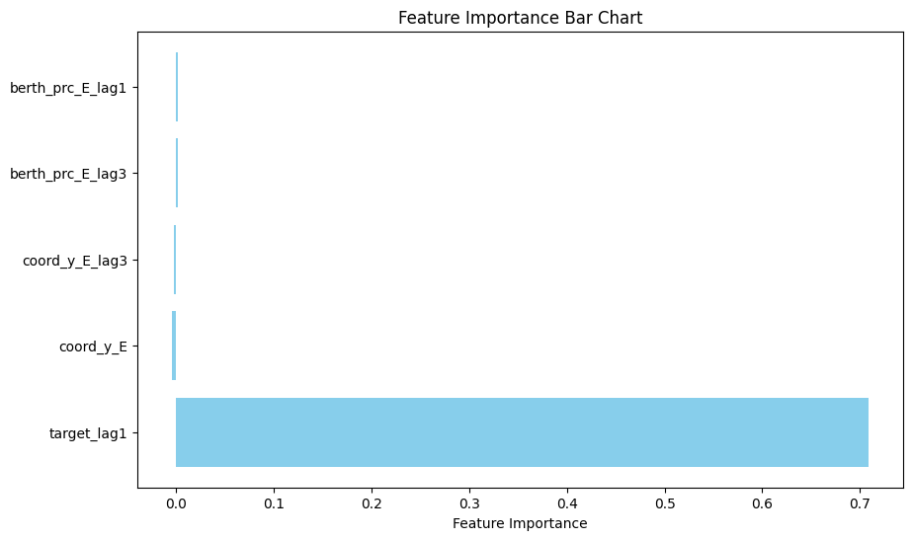
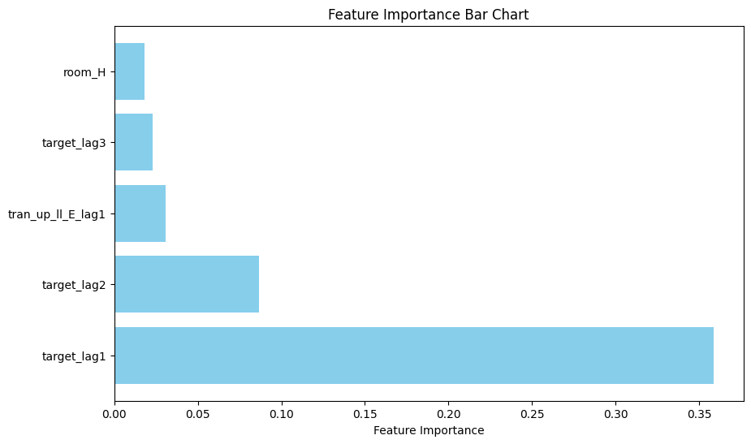
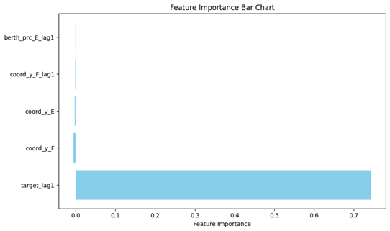
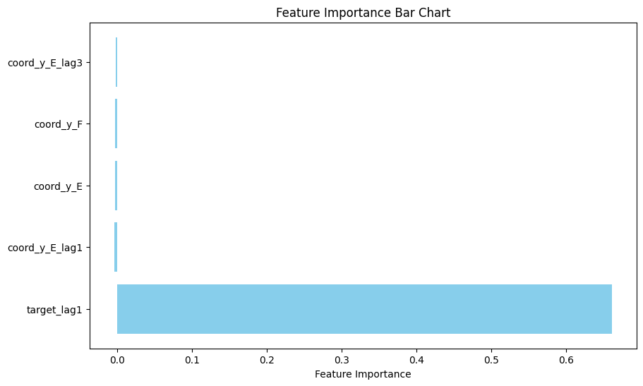
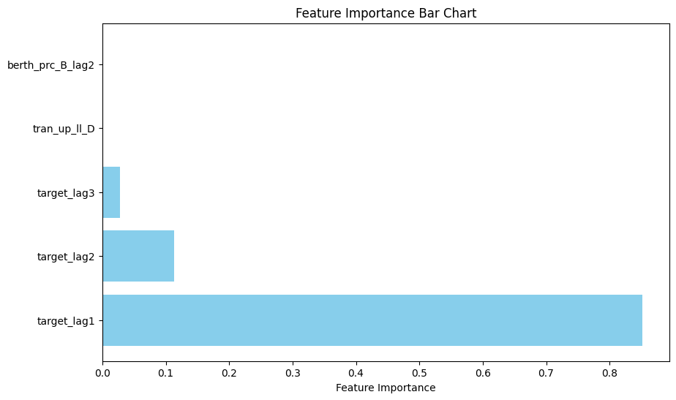
台北(A)、台中(B)、台南(D)、高雄(E)、新北(F)、桃園(H)
Feature Importance
以下為每支股票中最好模型的重要特徵
01001T: LR
01002T: LR
01004T: LR
01007T: LR
01009T: XGboost
01010T: RF

Slide 37
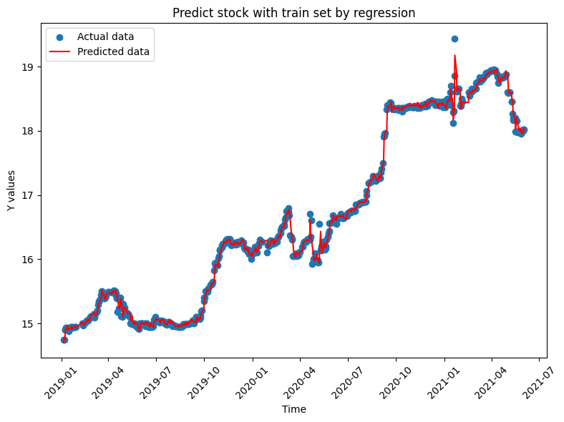
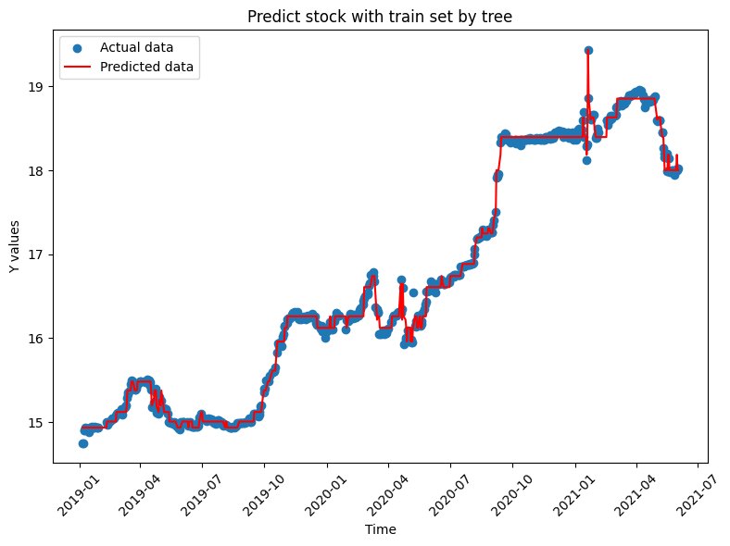
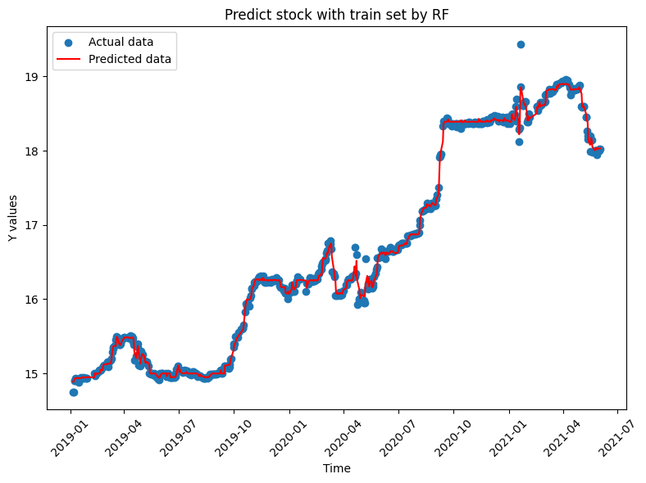
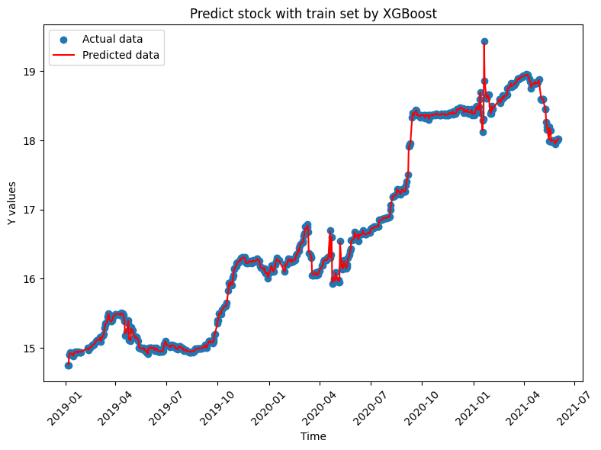
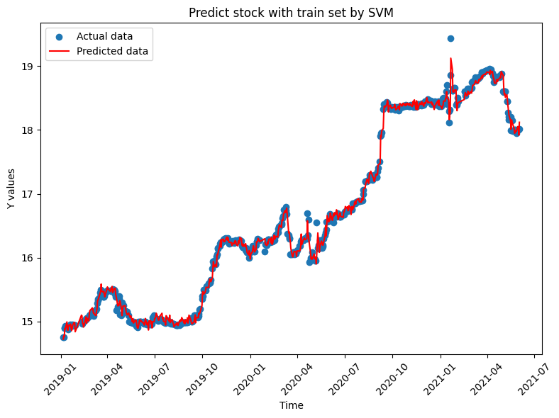
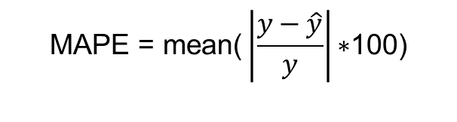
$$\text{MAPE} \text{= }\text{mean}\text{(}\left|\frac{y−\hat{y}}{y}\right|\text{∗100)}$$
模型擬合- 01001T
 | MAPE | RMSE
LR | 0.2602 | 0.0875
DT | 0.0833 | 0.0344
RF | 0.0833 | 0.0614
XGboost | 0.0358 | 0.0078
SVM | 0.3358 | 0.0933
Notes:
平均絕對百分比誤差

Slide 38
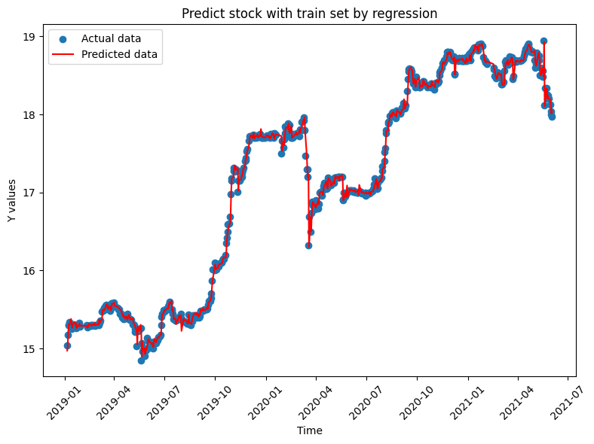
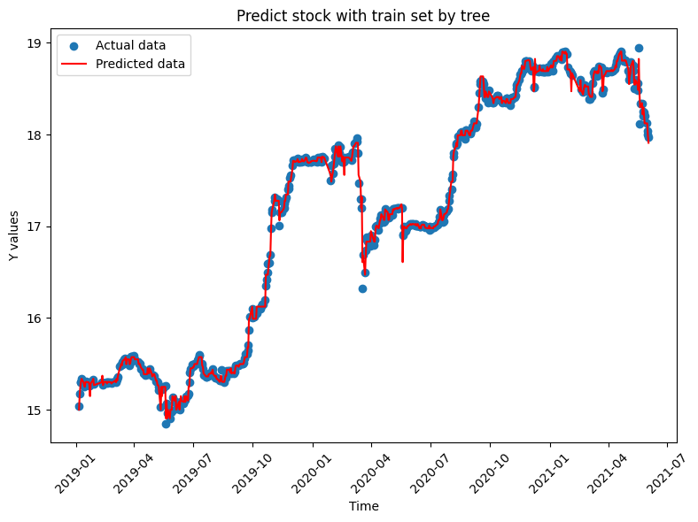
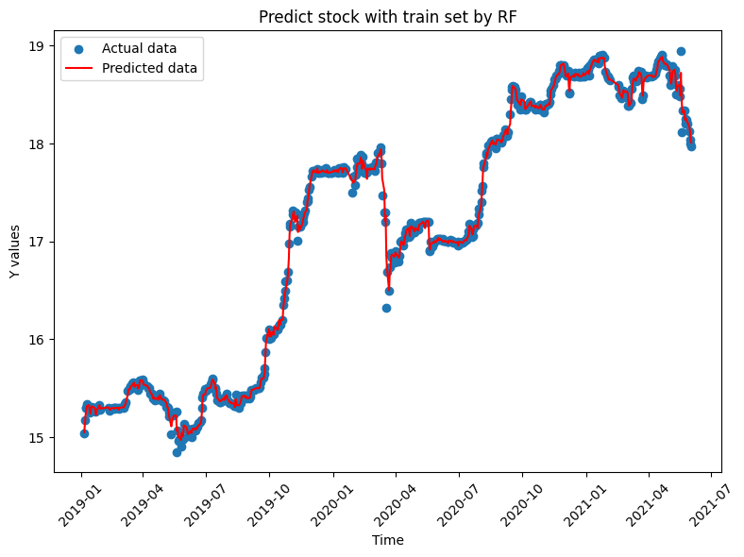
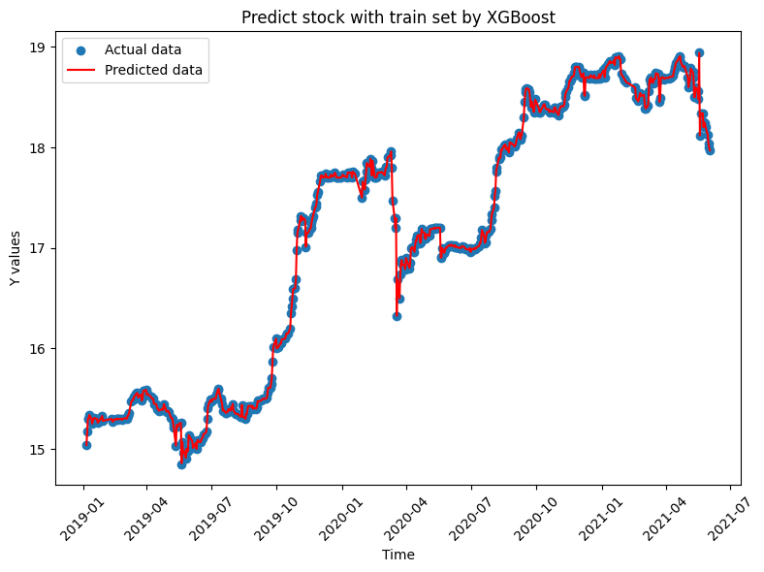
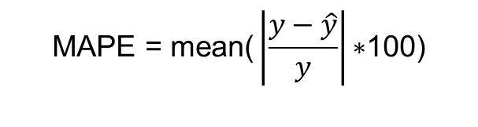
$$\text{MAPE} \text{= }\text{mean}\text{(}\left|\frac{y−\hat{y}}{y}\right|\text{∗100)}$$
模型擬合- 01002T
 | MAPE | RMSE
LR | 0.2619 | 0.0851
DT | 0.1229 | 0.0392
RF | 0.1300 | 0.0431
XGboost | 0.0073 | 0.0017
SVM | 0.3168 | 0.0895

Slide 39
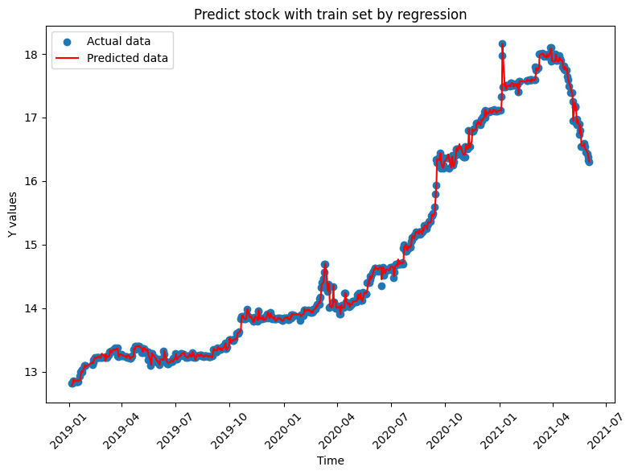
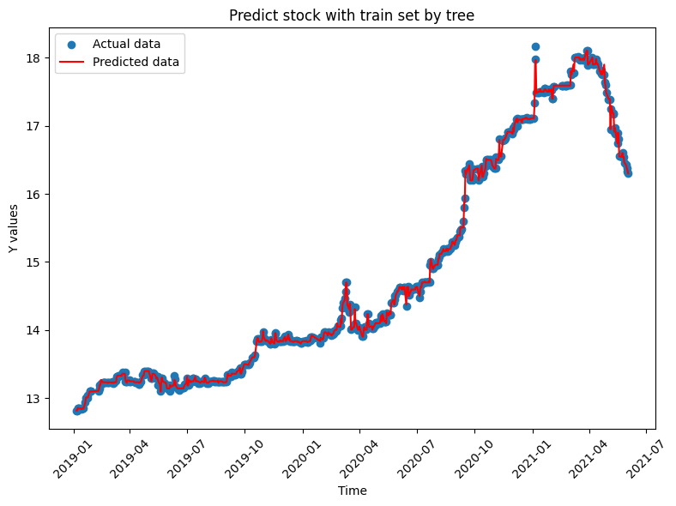
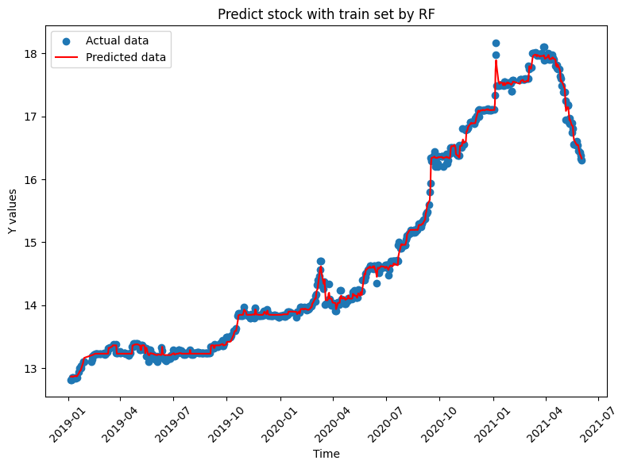
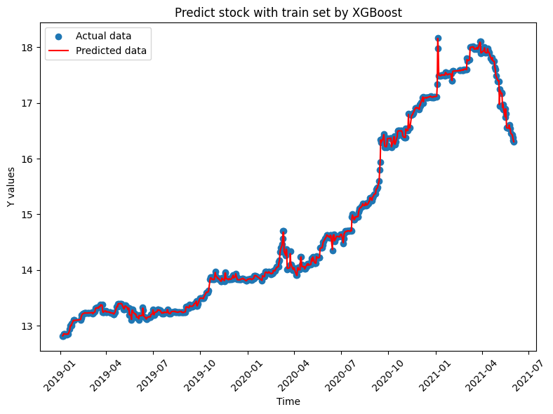
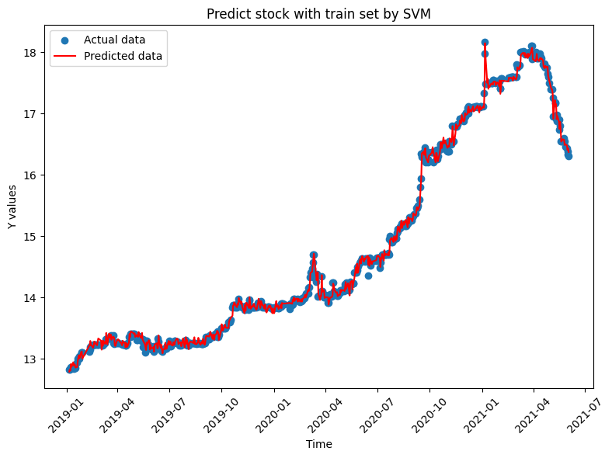
$$\text{MAPE} \text{= }\text{mean}\text{(}\left|\frac{y−\hat{y}}{y}\right|\text{∗100)}$$
模型擬合- 01004T
 | MAPE | RMSE
LR | 0.2829 | 0.0797
DT | 0.0732 | 0.0219
RF | 0.2730 | 0.0602
XGboost | 0.0371 | 0.0077
SVM | 0.3733 | 0.0856

Slide 40
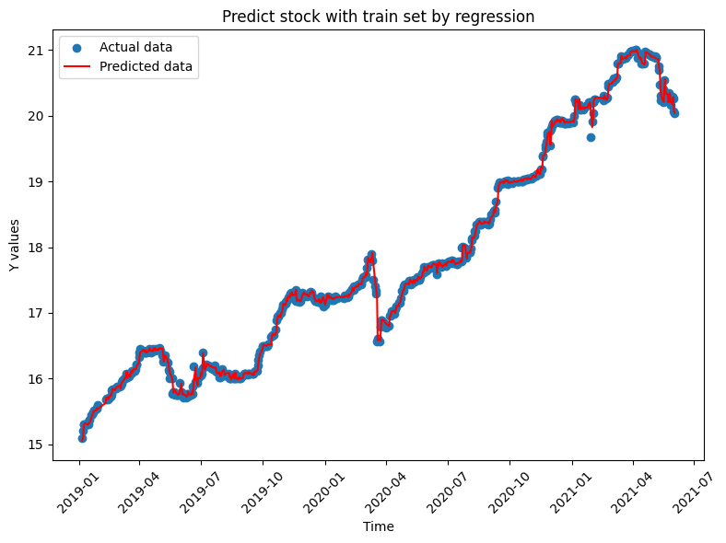
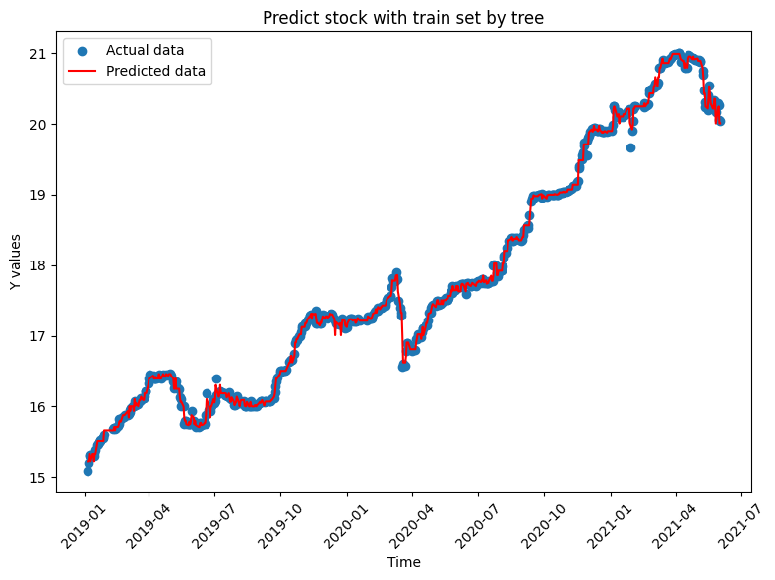
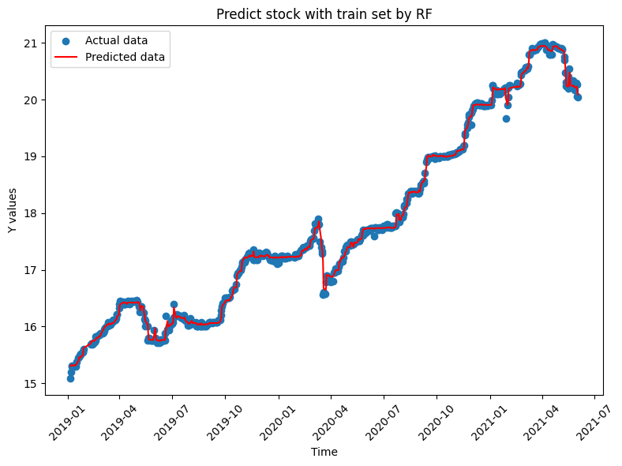
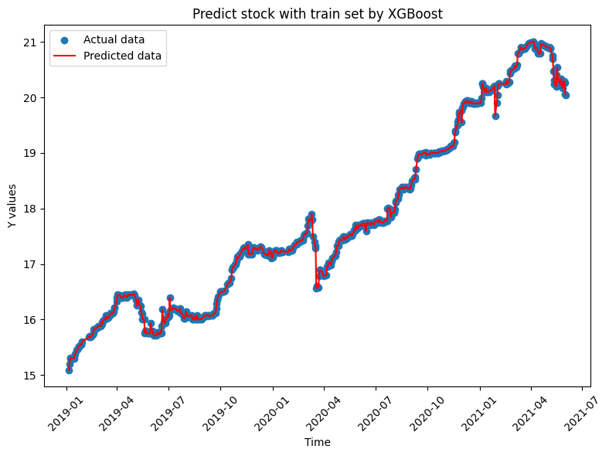

$$\text{MAPE} \text{= }\text{mean}\text{(}\left|\frac{y−\hat{y}}{y}\right|\text{∗100)}$$
模型擬合- 01007T
 | MAPE | RMSE
LR | 0.2150 | 0.0680
DT | 0.1293 | 0.0418
RF | 0.2262 | 0.0619
XGboost | 0.0017 | 0.0004
SVM | 0.2818 | 0.0747

Slide 41





$$\text{MAPE} \text{= }\text{mean}\text{(}\left|\frac{y−\hat{y}}{y}\right|\text{∗100)}$$
模型擬合- 01009T
 | MAPE | RMSE
LR | 1.6096 | 0.1908
DT | 0.1895 | 0.0378
RF | 0.2178 | 0.0435
XGboost | 0.0966 | 0.0120
SVM | 1.6173 | 0.1929

Slide 42





$$\text{MAPE} \text{= }\text{mean}\text{(}\left|\frac{y−\hat{y}}{y}\right|\text{∗100)}$$
模型擬合- 01010T
 | MAPE | RMSE
LR | 0.9694 | 0.1311
DT | 0.1420 | 0.0221
RF | 0.0790 | 0.0130
XGboost | 0.0033 | 0.0005
SVM | 0.9953 | 0.1331

Slide 43






模型預測
2
3
4
STD: 0.2229
平均變化量: 0.0306
STD: 0.1191
平均變化量: 0.0296
STD: 0.1442
平均變化量: 0.0199
1
6
5
STD: 0.2283
平均變化量: 0.0528
STD: 0.0389
平均變化量: 0.0175
STD: 0.2058
平均變化量: 0.0194

Slide 44





$$\text{MAPE} \text{= }\text{mean}\text{(}\left|\frac{y−\hat{y}}{y}\right|\text{∗100)}$$
模型預測- 01001T
 | MAPE | RMSE
LR | 0.4512 | 0.2664
DT | 1.9913 | 0.4280
RF | 1.2432 | 0.2503
XGboost | 0.7601 | 0.1802
SVM | 0.4800 | 0.2723

Slide 45





$$\text{MAPE} \text{= }\text{mean}\text{(}\left|\frac{y−\hat{y}}{y}\right|\text{∗100)}$$
模型預測- 01002T
 | MAPE | RMSE
LR | 0.1800 | 0.0473
DT | 0.3582 | 0.0814
RF | 0.2308 | 0.0527
XGboost | 0.2032 | 0.0505
SVM | 0.1913 | 0.0515

Slide 46





$$\text{MAPE} \text{= }\text{mean}\text{(}\left|\frac{y−\hat{y}}{y}\right|\text{∗100)}$$
模型預測- 01004T
 | MAPE | RMSE
LR | 0.2026 | 0.0549
DT | 1.4743 | 0.2722
RF | 2.1551 | 0.3471
XGboost | 0.8302 | 0.1661
SVM | 0.2637 | 0.0682

Slide 47





$$\text{MAPE} \text{= }\text{mean}\text{(}\left|\frac{y−\hat{y}}{y}\right|\text{∗100)}$$
模型預測- 01007T
 | MAPE | RMSE
LR | 0.2854 | 0.1310
DT | 1.0195 | 0.2523
RF | 1.0485 | 0.2362
XGboost | 0.9161 | 0.2142
SVM | 0.3164 | 0.1316

Slide 48





$$\text{MAPE} \text{= }\text{mean}\text{(}\left|\frac{y−\hat{y}}{y}\right|\text{∗100)}$$
模型預測- 01009T
 | MAPE | RMSE
LR | 5.5531 | 0.5133
DT | 0.6710 | 0.0736
RF | 0.4759 | 0.0510
XGboost | 0.4308 | 0.0484
SVM | 5.6900 | 0.5272

Slide 49





$$\text{MAPE} \text{= }\text{mean}\text{(}\left|\frac{y−\hat{y}}{y}\right|\text{∗100)}$$
模型預測- 01010T
 | MAPE | RMSE
LR | 2.4291 | 0.4327
DT | 0.4523 | 0.0618
RF | 0.3380 | 0.0477
XGboost | 0.3495 | 0.0469
SVM | 2.5308 | 0.4544

Slide 50
模型擬合與預測-Summary
 | MAPE |  |  |  |  |  | RMSE
 | 01001T | 01002T | 01004T | 01007T | 01009T | 01010T | 01001T | 01002T | 01004T | 01007T | 01009T | 01010T
LR | 0.2602 | 0.2619 | 0.2829 | 0.2150 | 1.6096 | 0.9694 | 0.0875 | 0.0851 | 0.0797 | 0.0680 | 0.1908 | 0.1311
DT | 0.0833 | 0.1229 | 0.0732 | 0.1293 | 0.1895 | 0.1420 | 0.0344 | 0.0392 | 0.0219 | 0.0418 | 0.0378 | 0.0221
RF | 0.0833 | 0.1300 | 0.2730 | 0.2262 | 0.2178 | 0.0790 | 0.0614 | 0.0431 | 0.0602 | 0.0619 | 0.0435 | 0.0130
XGboost | 0.0358 | 0.0073 | 0.0371 | 0.0017 | 0.0966 | 0.0033 | 0.0078 | 0.0017 | 0.0077 | 0.0004 | 0.0120 | 0.0005
SVM | 0.3358 | 0.3168 | 0.3733 | 0.2818 | 1.6173 | 0.9953 | 0.0933 | 0.0895 | 0.0856 | 0.0747 | 0.1929 | 0.1331
模型擬合總表
 | MAPE |  |  |  |  |  | RMSE
 | 01001T | 01002T | 01004T | 01007T | 01009T | 01010T | 01001T | 01002T | 01004T | 01007T | 01009T | 01010T
LR | 0.4512 | 0.1800 | 0.2026 | 0.2854 | 5.5531 | 2.4291 | 0.2664 | 0.0473 | 0.0549 | 0.1310 | 0.5133 | 0.4327
DT | 1.9913 | 0.3582 | 1.4743 | 1.0195 | 0.6710 | 0.4523 | 0.4280 | 0.0814 | 0.2722 | 0.2523 | 0.0736 | 0.0618
RF | 1.2432 | 0.2308 | 2.1551 | 1.0485 | 0.4759 | 0.3380 | 0.2503 | 0.0527 | 0.3471 | 0.2362 | 0.0510 | 0.0477
XGboost | 0.7601 | 0.2032 | 0.8302 | 0.9161 | 0.4308 | 0.3495 | 0.1802 | 0.0505 | 0.1661 | 0.2142 | 0.0484 | 0.0469
SVM | 0.4800 | 0.1913 | 0.2637 | 0.3164 | 5.6900 | 2.5308 | 0.2723 | 0.0515 | 0.0682 | 0.1316 | 0.5272 | 0.4544
STD |  |  |  |  |  |  | 0.2229 | 0.1191 | 0.1442 | 0.2283 | 0.0389 | 0.2058
模型預測總表

Slide 51
未來工作
Ensemble Learning
Groupby資料間隔以週為單位，測試更長期的資料

Slide 52

Group meeting records

Slide 53

Group meeting records
2023/12/17

